Slide 1
MKTG 571:
Customer Profitability
RFM and PCV Analysis

Slide 2
Today’s Agenda
To discuss how some firms value their customer bases for customer selection and resource allocation
To show how RFM and PCV measures are calculated and used by some firms
To introduce CLV and how it is calculated

Slide 3
Valuing Customers
It is important to predict a customer’s value to the firm because it can help with:
  Customer and Prospect Selection
  Optimal Resource Allocation
So, how do we predict this value?

Slide 4
Valuing Customers
Types of predictive models:
  Statistical
    ‘Analyst Driven’ (e.g. Regression Models)
    ‘Data Driven’ (e.g. Decision Trees, Neural Networks)
  Non-Statistical
    Heuristics and Rule of Thumb (e.g. RFM)

Slide 5
RFM Analysis
Initially widely used by direct marketers
Conceptually it suggests that better customers:
  Purchase more recently
  Purchase more frequently
  Purchase larger amounts of products
  How much information is in these 3 variables?

Slide 6
RFM Analysis
Can look at R, F, and M separately
Can combine the three into an RFM index
Different Approaches:
  Sorting
    Independent n-tile approach
    Sequential n-tile approach
    Intuitive groupings approach
  Weighting
    Regression
    Managerial judgment

Slide 7
Independent Sorting
Create quintiles (not deciles) for recency
  With deciles there would be (10)³ = 1000 RFM cells
  With quintiles there are (5)³ = 125 RFM cells
Create quintiles for frequency
Create quintiles for monetary
Combine them to determine RFM cell
  If a customer is in quintile 1 for recency, quintile 3 for frequency and quintile 2 for monetary – then the RFM cell is 132

Slide 8
Independent Sorting
M
R
F
M
1
1
1
2
2
2
3
3
3
4
4
4
5
5
5

Slide 9
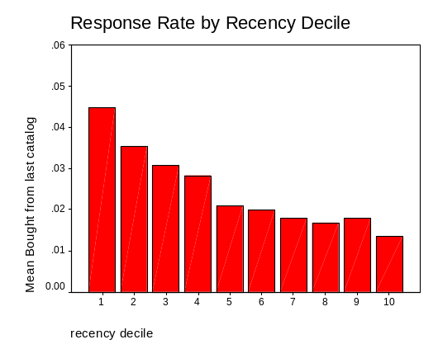
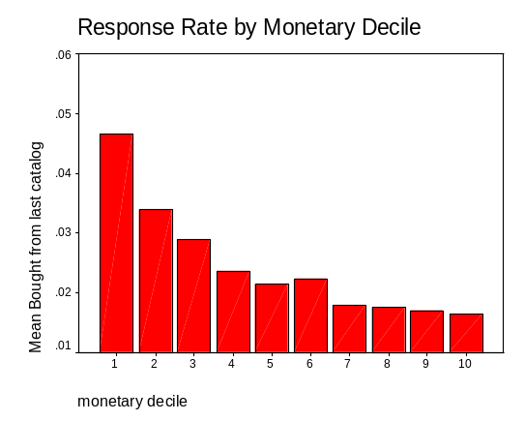
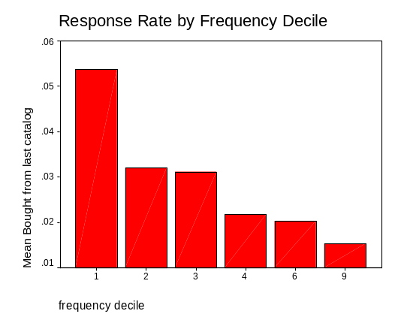
Independent Sorting
Recency:
Monetary:
Frequency:
** These results are from the Tuscan Lifestyles Case

Slide 10
Sequential Sorting
Create quintiles (not deciles!) for recency
Within each recency quintile, create quintiles for frequency
  That is, take everyone in recency quintile 1. Sort them from best to worst on frequency. Top fifth are in quintile 1 for frequency, etc.
  Repeat this for each of the five recency quintiles
Within each of the 25 recency – frequency groups, create quintiles for monetary
Combine them to determine RFM cell
  If a customer is in quintile 1 for recency, quintile 3 for frequency and quintile 2 for monetary – then the RFM cell is 132

Slide 11
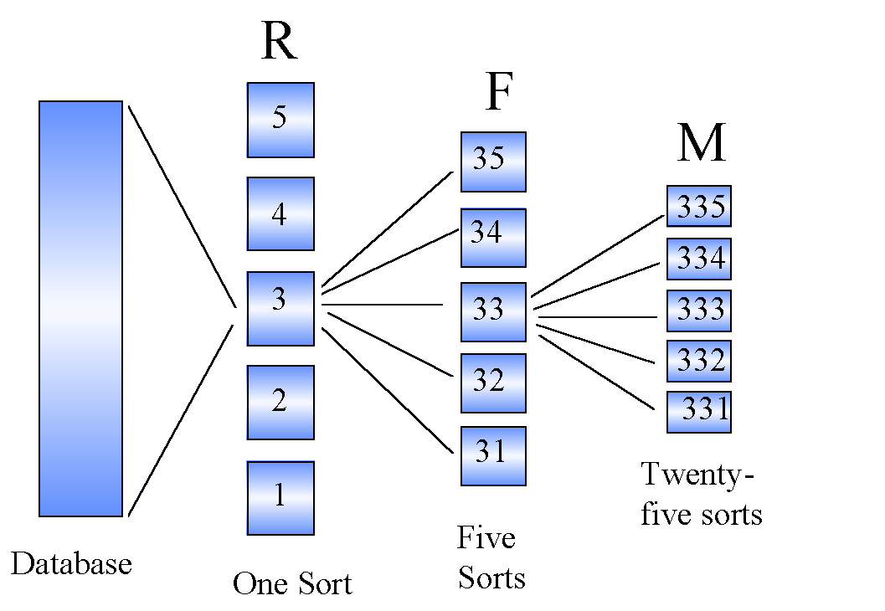
Sequential Sorting

Slide 12
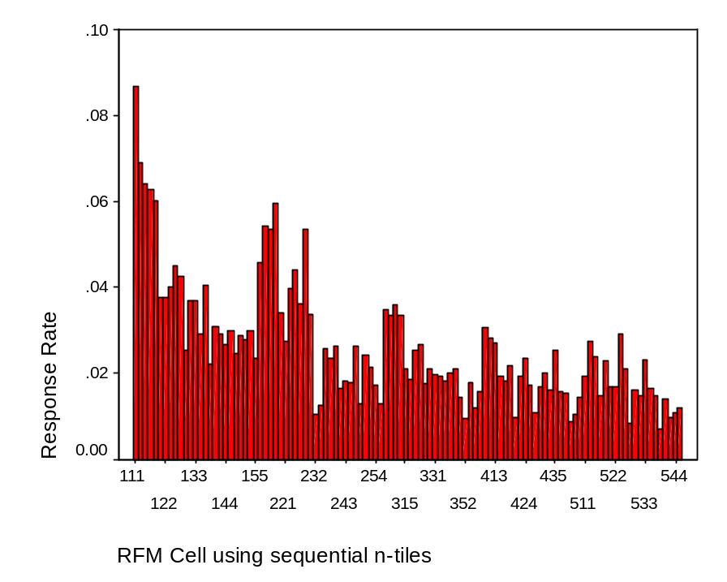
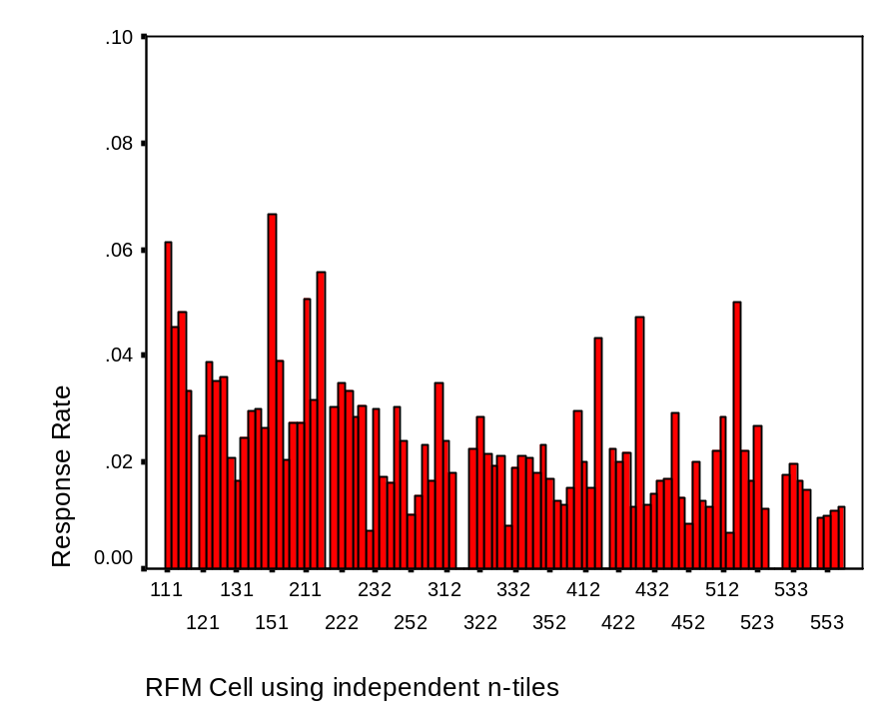
Response Rates by RFM Cell
Sequential Sorting
Independent Sorting
** These results are from the Tuscan Lifestyles Case

Slide 13
Independent vs. Sequential
Cell Sizes
  Independent approach yields unequal (often dramatically so) cell sizes
  Sequential approach yields more nearly equal cell sizes
(Absolute) Comparisons Across Different Cells
  With the independent approach a ‘232’ customer will always have spent less than an ‘341’ customer, but this is not necessarily true using the sequential n-tile approach (where 1’s designate top quintiles)
Implicit Weighting
  Sequential approach implicitly weights R more than F and F more than M

Slide 14
A Comparison
Customer ID | Days since last purchase | Total # of purchases | Total Dollars Spent | Ind. RFM | Seq. RFM
1 | 207 | 7 | 493 | 211 | 214
4 | 778 | 3 | 271 | 522 | 522
From the above table we see that:
Customer 1 is a more recent customer (207 versus 778 days since last purchase)
Customer 1 is a more frequent customer (7 versus 3 purchases)
Customer 1 has spent more money in total ($483 versus $271)
These three comparisons hold for the independent RFM cells (2 is ‘better’ than 5, 1 is ‘better’ than 2, and 1 is ‘better’ than 2)
But, when using the sequential approach, customer 1’s M group drops from 1 to 4. This means that, compared with other customers who are fairly recent and in the top frequency group – this customer hasn’t spent very much in total.

Slide 15
Strategic Decisions
What marketing initiative would you propose for these ‘cells’?
R F M (where 1=best, 5 is worst)
1 1 4
4 1 1
5 5 5
1 5 5

Slide 16
RFM Analysis at BB
BookBinders Problem:
  Which customers should receive a targeted mailing?
  What about for The Art History of Florence?
  How do we tell that RFM is doing a good job?

Slide 17
RFM Analysis at BB
Setup:
  Selected random sample of 50,000 customers from database
  Sample was mailed an offer to purchase The Art History of Florence
  Objective was to use the results of the test mailing to identify which groups of customers are most likely to respond

Slide 18
RFM Analysis at BB
Bought Art History | Months since Last Purchase | Total # Purchases | Total $ Spent
No | 12.73 | 3.758 | 205.7348
Yes | 8.61 | 5.219 | 234.3014
Total | 12.36 | 3.890 | 208.3183

Slide 19
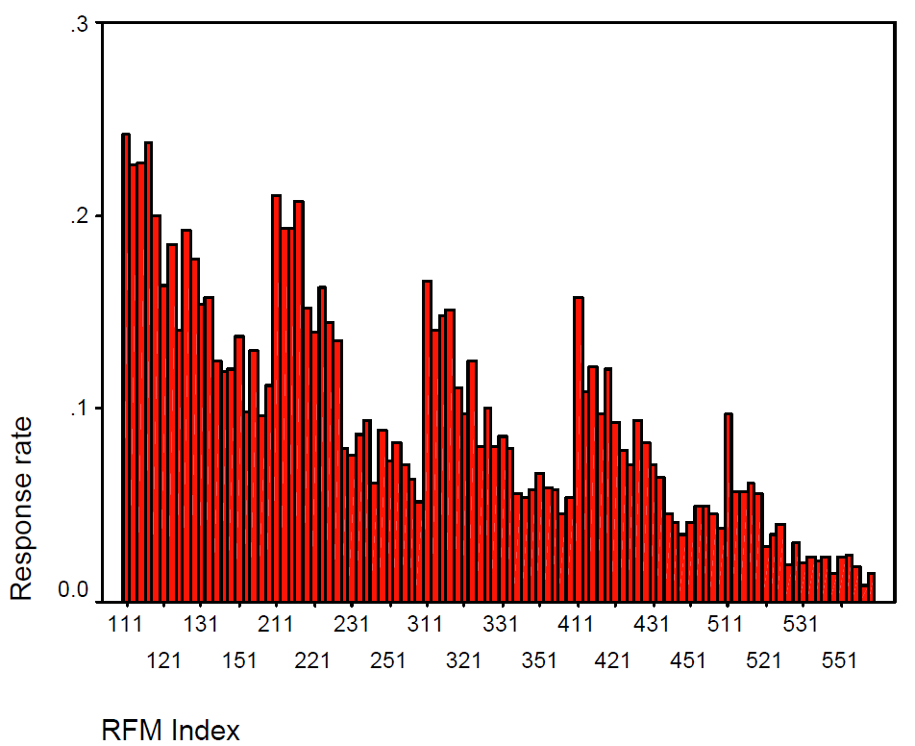
RFM Analysis at BB
Breakeven Response Rate:
  = (cost to mail offer) / (net profit from 1 sale)
  = $0.50/ ($18 - $9 - $3)
  = $0.50/$6 = 8.3%
8.3%

Slide 20
RFM Analysis at BB
Profitability Analysis | Mass Mailing | Targeted: Sequential Sort RFM
Number of Customers | 50,000 | 50,000
Number Mailed | 50,000 | 22,731
% of Customers Mailed | 100% | 45.46%
Number of Buyers | 4522 | 3214
Response Rate | 9.04% | 14.14%
Gross Revenues | $81,396 | $57,852
COGS | $40,698 | $28,926
Shipping | $13,566 | $9,642
Mailing | $25,000 | $11,365.50
Gross Profit | $2,132 | $7,918.50
Return on Marketing | 8.53% | 69.67%

Slide 21
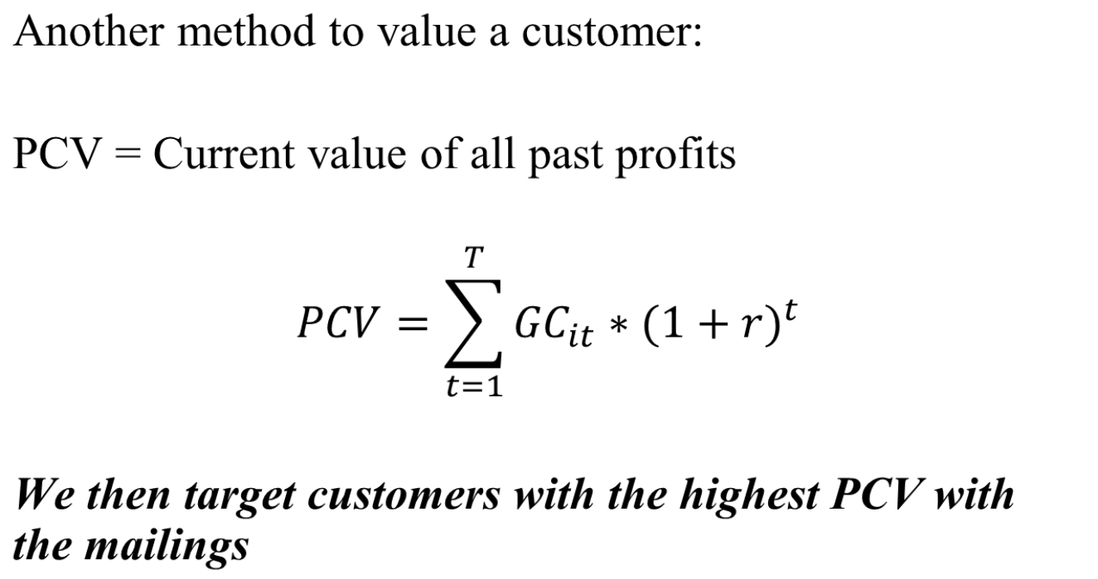
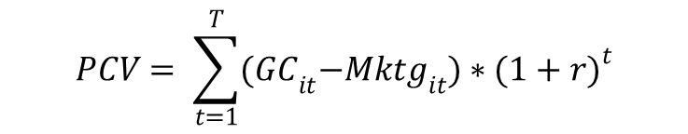
Past Customer Value (PCV)

Slide 22
PCV and RFM
Benefits of RFM?
Benefits of PCV?
Can we put the benefits together?

Slide 23
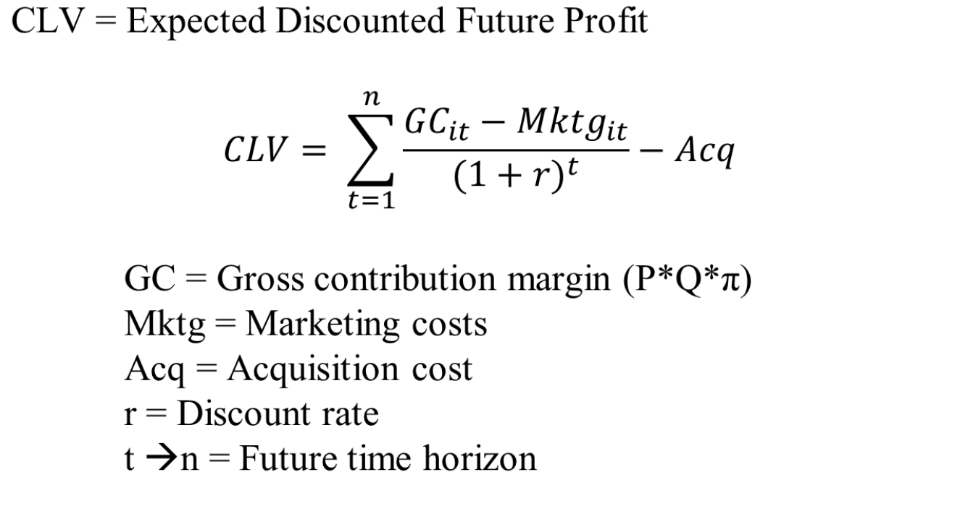
Customer Lifetime Value

Slide 24
CLV for Tuscan Lifestyles
Tuscan Lifestyles : Initial order < $50
Revenue | Time 0 | Year 1 | Year 2 | Year 3 | Year 4 | Year 5
Prospects | 202478
Customers | 4657 | 4657 | 4657 | 4657 | 4657 | 4657
Active customers | 4657
Response Rate | 2.30%
Retention Rate
Avg # Orders | 1
Number of Orders | 4657
Order Size | $31.84
Revenues | $148,278.88
Costs
COGS + other direct VC | $86,002
Mailings | $172,107
Profits
Gross Profit | ($109,829.39)
Year | 0 | 1 | 2 | 3 | 4 | 5
Discount rate
NPV profit | ($109,829.39)
Cumulative NPV profit | ($109,829.39)
Customer LTV | ($23.58)

Slide 25
Optional Workshops
Getting your hands dirty with data using SAS
Dates:
Let’s discuss some dates/times

Slide 26
For Next Class
Topic:
  Customer Profitability: Customer Lifetime Value (CLV)
Reading:
  None
Assignment:
  Individual Assignment: Tuscan Lifestyles: Assessing CLV

